Slide 1
Stage 2 Home Learning Workbook - Week 10
Home Learning Suggested Timetable:
This is a suggested timetable for students completing Home Online Learning. Please note that this is just a guideline and that it is not compulsory for students to complete everything on the timetable each day.
Subject Area: | Suggested Duration
Literacy: Reading, Comprehension, Spelling and Writing | 2 hours each day (Including 30 minutes reading) (Morning)
Mathematics: Number and Algebra & Measurement and Geometry | 1.5 hours each day (Midday)
Other Subjects: Geography, Science, PDHPE & CAPA (Creative Arts & Performing Arts) | 30 minutes per subject (Midday/Afternoon)
Key: Any word with a blue underline is a hyperlink e.g. Google
Click on the add button on the top left hand side (+)

Slide 2
Reading log
Students should read for at least 30 minutes a day. Please record reading in the log below.
Epic Books
Book Title |  |  | Date | Minutes | Pages | Read to self, read to someone or listen to reading?
Eg. Harry Potter and the Chamber of Secrets |  |  | 18.03.20 | 35 minutes | 13 pages | Read with mum

Slide 3
Spelling
Complete a new activity from the grid below each day. Use the slides online to complete.
Year 3 Words | Year 4 Words
Saturday Sunday here ship chop food fire loud from eye fight friend done any great | captain uncle minute island love birthday reached tried couldn’t under behind kept both must ready

Slide 4
“The Solar System” - Editing
The soler system is made up of eight planet’s which orbit around the Sun.
The four smaller planets closest to the Sun are mercury, Venus earth and Mars. They made up of rock and metel. The four outer planets are much larger. The too largest are Juptier and Saturn, comosd mainly of hydrogen adn helium. The outermost Planets are Uranus and “Neptune”. They are composed largely of ices, including frozen water ammonia and methane
our solar system is located within one of outer arms of the milky way galaxy, witch contains about 200 billion stars.
Editing Task: Complete the editing passage in the space provided below. (Highlight the errors you have corrected)

Slide 5
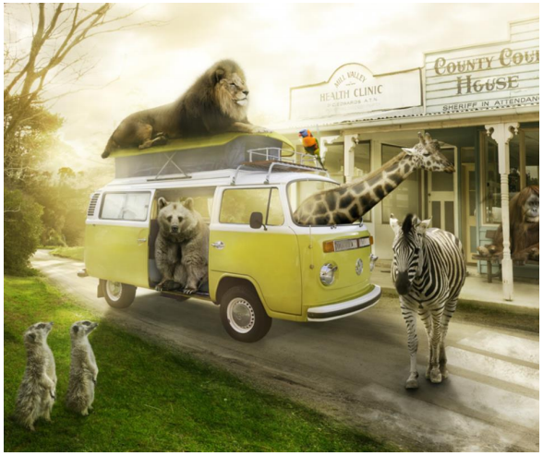
Story Writing
Write a story based on the picture.
Check List:
Before beginning: Plan your writing - characters, setting and plot (pebble, brick, boulder) Introduction: Sizzling start Problem: Pebble, brick and boulder Tightening Tension Dynamic Dialogue Show, don’t tell Ban the boring Conclusion Ending with impact! Resolution (solve the problem)

Slide 6
Writing - Compound Sentences
A compound sentence uses a fanboy word to join two simple sentences together.
Choose which conjunction works best to join the simple sentences together to make a compound sentence.
FANBOYS
FOR AND NOR BUT OR YET SO
I would like to go to the movies ________________ I don’t have a ticket.
Sally is coming over _______________ we can bake some cookies.
Our family went for a bushwalk _______________ they saw many types of flora and fauna.
I like dogs ________________ Grace likes cats.
Alex doesn’t like to eat carrots ______________ he likes to eat cookies.
Rewrite the sentences below to create a compound sentence.
The boy went to the park. He played with his dog.
_________________________________________________________________________________
_________________________________________________________________________________
Ashleigh went for a swim at the beach. Rachel read a book on the sand.
__________________________________________________________________________________________________________________________________________________________________

Slide 7
Mathematics
Search different matific activities and complete them. Record activities below:
Matific:
Number and Algebra Topics: Addition, Subtraction, Division and Multiplication |  |  | Measurement and Geometry Topics: Time
Name of activity: | Date Completed: |  | Name of activity: | Date Completed:

Slide 8
Choose two of the following activities and complete in the space provided.
Choose two of the following activities and complete in the space provided.

Slide 9
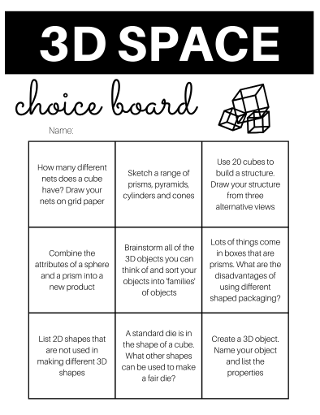
Choose two of the following activities and complete in the space provided.
Choose two of the following activities and complete in the space provided.

Slide 10
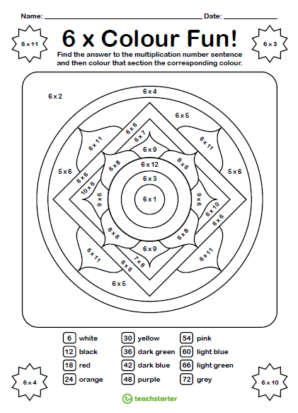

Slide 11
Stage 2 Science
Inquiry Question: I can use information gathered from previous lessons to create and design a new animal living in its environment.
Task:
Create a new animal with a range of features. Think about the following:
What does it look like?
Where does it live?
What is the climate like?
Does it have any Predators?
Is it a large or small animal?
Does it have fur, scales, hair or skin?
Does it have claws or hands or paws?
Think about the physical characteristics of your new animal and what physical features will help it survive in its habitat.
Draw a picture of your animal and label its special physical features.
Write a report about your animal and where it lives.
Extension: Students will be required to design their animal using SCRATCHJnr and coding a scene from their habitat. Scratch Tutorial

Slide 12
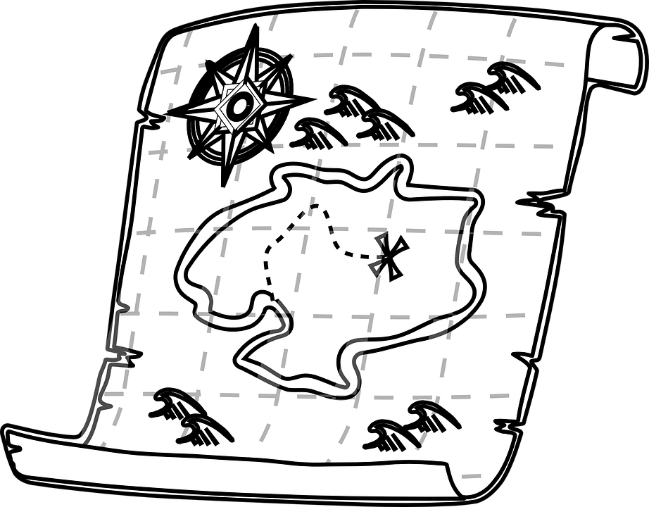
Geography Activity Grid Weeks 9 - 11 Each week choose 2 activities to complete.
Try and draw a map of your neighbourhood from memory. Include all the interesting locations or features. (Use the exercise book provided) | Use an atlas or Google Earth to locate your suburb/town where you live. Try and find your street. | Try and list all the interesting locations in your area. Include beaches, parks, or other special places. (Use the exercise book provided) | Create a map for your own perfect island. Include areas that might be important to the community. Include housing, schools, business etc. (Use the exercise book provided)
Create a travel poster for visiting Sydney. Make sure you include features that are nearby to Matraville. (Use the exercise book provided) | Investigate the flag of Australia and what it means. Draw the flag. Investigate and draw a flag from another country. (Use the exercise book provided) | Create a postcard to send to a friend. Decorate one side with features and/or monuments from Australia. (Use the exercise book provided) | Keep a journal of the weather each day. Note the changes throughout the day and time. Compare the weather as the seasons change. (Use the exercise book provided)
Create your own treasure map. Make sure you provide instructions for those who need to seek the treasure. (Use the exercise book provided) | Using a map of Australia. Locate your state and colour this in. Locate Sydney and label on the map. Try and label any other towns or states. | Draw a map of your home. Include all the rooms and furniture. (Use the exercise book provided) | Compare the climate of Australia with another country in the world. What are the differences? What are the similarities?

Slide 13
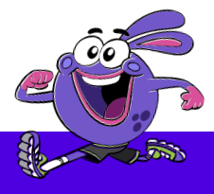
PDHPE
Life Skills:
Keep up with your chores or home activities. This will help your family and teach you valuable skills!
Movement:
Choose 3 activities from each grid to keep yourself active!
OR Try:
GoNoodle for fun: Trolls GoNoodle

Slide 14
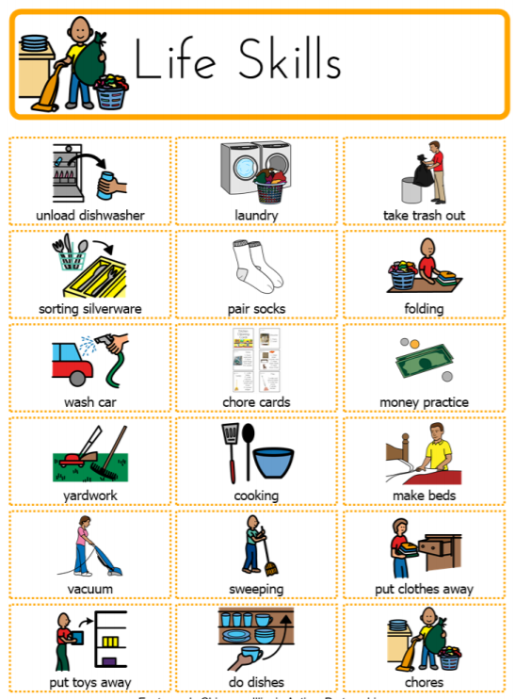
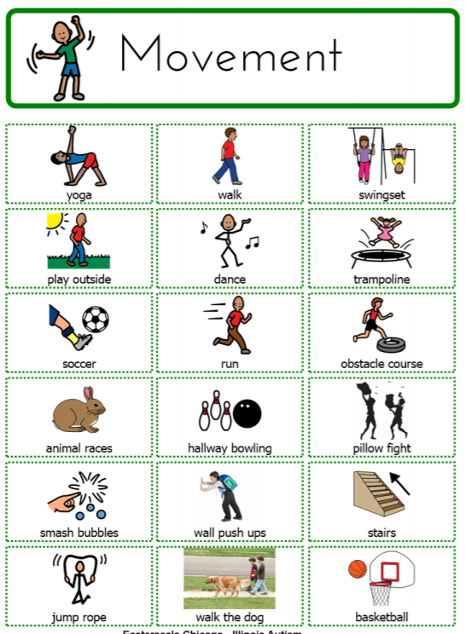

Slide 15
CAPA Activity Grid Weeks 9 - 11 Each week choose 2 activities to complete.
Make up your own dance or song. Perform for your family. | Draw a portrait of someone in your family. It could even be your pet! (Use the exercise book provided) | Participate in a GoNoodle dance activity that you enjoy. | Re-write the story of The Three Little Pigs so that it is a modern version. Create a script that you could perform with your family. (Use the exercise book provided)
If you have any instruments at home, make sure you practise! OR try to make your own DIY Instuments | With a member of your family, try to mime an action and see if they can guess what you are doing. | Draw a picture of your local park. Add some interesting activities that you would like to see there. (Use the exercise book provided) | Play your favourite song and try to make up a dance to match the mood and temp of the song.
 | Using objects from around your home or from nature, create a still life scene that you can draw. (Use the exercise book provided) | Write a short play to help people understand our school values; Respect, Responsibility, Learning and Safety. (Use the exercise book provided) | Create a directed drawing using the link provided on the next slide. (Use the exercise book provided)

Slide 16
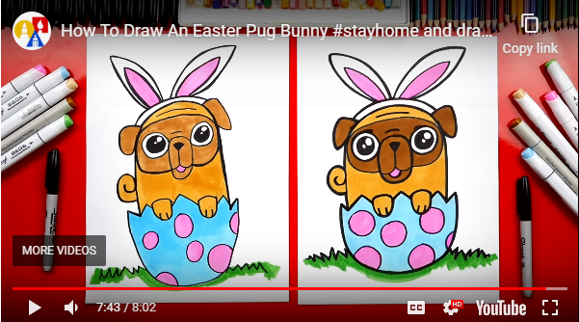
Directed Drawing - Easter Pug Drawing
Follow the link to create your very own Easter Pug!
ArtForKidsHub-EasterPug

